Slide 1
Guidelines for the Required School Site Council (SSC) and English Learner Advisory Committee (ELAC) Orientation and Elections
BUL 6745.2 Guidelines for the Required School Site Council and English Learner Advisory Committee
Notes:
Good morning:
This orientation is for both the school’s SSC and the ELAC committees.
We will be reviewing this morning the items that pertain to both SSC and ELAC and then we will focus on the purpose and responsibilities of the SSC and then on the ELAC.
Please place your questions on a post it and place them on our Parking Lot section.

Slide 3
Attendance Link
Please use the following link to sign-in:
https://forms.gle/9ApQaD34q7fJg3Ys5
The link has also been added to the chat.

Slide 4
Presentation Access
If you would like to follow along with the presentation, please visit our website:
achieve.lausd.net/nwpace

Slide 5
Purpose
To review the functions and operation of the mandated School Site Council (SSC) and the English Learner Advisory Committee (ELAC)
Understand the roles and responsibilities of the School Site Council Committee (SSC) and English Learner Advisory Committee (ELAC) members
Understand the orientation and election process for the SSC and ELAC
Notes:
Read the purpose for todays meeting as outlined in slide 2.

Slide 6
Greene Act
The SSC and ELAC operate under the Greene Act which means that the meetings must:
Be conducted as public meetings with agendas posted 72 hours before the meeting outside of the school building in a plainly visible location
The agenda must specify the date, time, and location of the meeting, the items to be addressed, and whether the items will require action to be taken.
A council/committee generally, may only act on or consider an item when it has been properly included on the agenda at the time of posting.
If action is taken on an item that was not listed as an action item on the agenda, the action taken is invalidated.
Notes:
The SSC and ELAC operate under the California Open Meeting Law provisions of the Greene Act which means that the meetings must be conducted as public meetings with agendas posted 72 hours before the meeting outside of the school building in a plainly visible location, and must be posted at the meeting location, if different than the school site. The agenda must specify the date, time, and location of the meeting, the items to be addressed, and whether the items will require action to be taken. A council or committee, generally, may only act on or consider an item when it has been properly included on the agenda at the time of posting. If action is taken on an item that was not listed as an action item on the agenda, the action taken is invalidated.

Slide 7
Greene Act (cont.)
Only under certain unusual circumstances and by a unanimous vote may the council or committee allow an item not on the agenda to be considered and/or acted upon.
When considering whether or not to allow a non-agenda item, the council or committee must determine if the item presents an urgent need for action, and the item/issue was unknown at the time the agenda was posted.
Notes:
An item that was not posted on the agenda can be added but it does need to have unanimous vote. The council or committee really needs to determine the urgency of the matter being proposed and the fact that this information was not known at the time the agenda was planned. As a reminder the public has the right to know when an item is being considered for action by a council or committee.

Slide 8
SSC and ELAC Agenda
In all cases, the SSC/ELAC agenda items must have relevance to the purpose and goals of the SSC/ELAC
The SSC/ELAC officers must participate in the planning of the agenda with designated school staff.
Changes to the SSC/ELAC agenda planned by the respective officers, before the posting of the meeting, must be in consultation with the SSC/ELAC officers.
All SSC/ELAC agendas must contain a public comment section.
Notes:
This slide is a reminder for all that the SSC and ELAC agendas must contain items that are relevant to the purpose and goals of the SSC and or ELAC.
We also would like to state that the SSC/ELAC officers will be part of the planning of the agenda and any changes which happens before the agenda is posted will be with consultation of the officers.
As was mentioned in the previous slide any changes to the agenda after the 72 hours posting must take place with the members voting on the changes.

Slide 9
Public Comment
During the public comment section on the agenda, any member of the public may address the body on any item within the jurisdiction of the council or committee in accordance with the Greene Act. Writing their name on a sign-in form is optional.
Anyone who is not serving as a member of the operating council or committee is considered a member of the public.
Notes:
During the public comment section on the agenda, any member of the public may address the body on any item within the jurisdiction of the council or committee in accordance with the Greene Act. Anyone who is not serving as a member of the operating council or committee is considered a member of the public.

Slide 10
Public Comment
Seated SSC or ELAC members cannot speak during public comment.
Public speakers may be limited to speak for 1, 2 or 3 minutes. It is advised to inform the public of such a rule at the start of every meeting. Such rule should be applied evenly to all speakers. Public speakers have the option of not signing in.
A timer or clock should be displayed to monitor the length of time allotted to each public speaker.
Notes:
Seated SSC or ELAC members cannot speak during public comment. All SSC/ELAC bylaws must include a standing rule regarding public comment procedures, including the number of speakers and the length and frequency of public comment. Public speakers may be limited to speak for 1, 2 or 3 minutes. It is advised to inform the public of such a rule at the start of every meeting. Such rule should be applied evenly to all speakers. Members of the Public that would like to speak during public comment time do not have to sign-in or explain why they want to speak during this time. A timer or clock should be displayed to monitor the length of time allotted to each public speaker. The form to register speakers for public comment should be collected immediately prior to the public comment agenda item.

Slide 11
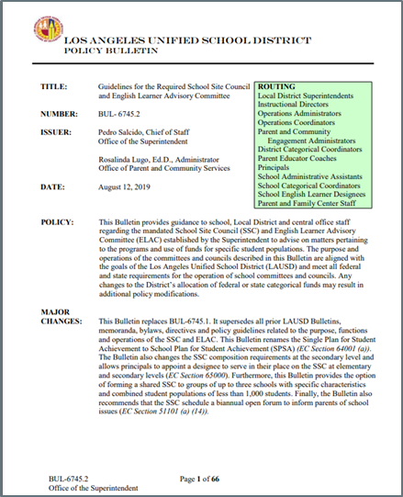
Reminder
All SSC and ELAC must provide an orientation before holding member elections. School staff must follow the guidelines found on the PCS website under, Tools for Schools. (https://achieve.lausd.net/Page/11304)
Notes:
We want to let the families know that we are following the District’s guidelines for the SSC and ELAC orientation and elections.

Slide 12
SSC/ELAC Members’ Responsibilities
Attend all meetings.
Vote in person.
Follow the Operating Norms and Code of Conduct.
Agree on the dates and times of meetings by vote at the first official business meeting, as possible. The principal may call additional meetings as needed in consultation with SSC/ELAC officers.
Participate in trainings to carry out their duties effectively.
Honor all decisions of the SSC/ELAC, even if these decisions differ from one’s personal opinions.
Resign from their position at any time, but must do so in writing, and must submit the signed letter of resignation to the principal or administrative designee.
Notes:
We would like to encourage you to become a member of the ELAC and or SSC committees/Councils at our school. These are the important responsibilities what SSC and ELAC members have when they become members. Read the slides…

Slide 13
Schools and families working together to ensure student success
ORIENTATION FOR THE SCHOOL SITE COUNCIL (SSC)
BUL 6745.2 Guidelines for the Required School Site Council and English Learner Advisory Committee
Revised: 7/20/19
Notes:
We are now going to start the orientation for the School Site Council. I will be explaining the role and responsibility of the SSC as described in BUL 6745.2 Guidelines for the Required School Site Council and English Learner Advisory Committee.

Slide 14
Pursuant to California Education Code…..
Education Code 65000 and 32281. (2)
Education Code 64001(a)
Every school with a County District School (CDS) code assigned by the California Department of Education (CDE) shall establish a School Site Council (SSC) as the decision-making council for all programs funded through the Consolidated Application (ConApp).
Requires districts receiving federal, state and other applicable funding, through the ConApp process, ensure that participating schools prepare a School Plan for Student Achievement (SPSA) .
Notes:
Why do we have an SSC….Read the slide
So this school does receive Title I funds which is part of the ConApp. As a member of the SSC you will participate in a lot of discussion regarding the Title I funds that the school receives.

Slide 15
School Site Councils: Functions and Responsibilities
The SSC is a decision-making council for all programs funded
through the Consolidated Application.
Develop, review and adopt the SPSA in consultation with relevant stakeholders and, where applicable, with the ELAC.
Respond in writing to ELAC’s written recommendations on the SPSA within 30 calendar days or at the next SSC meeting.
Ensure that all federal parental and family engagement mandates are met.
Develop the Integrated Safe School Plan, as described in Reference Guide 5511.8.
Notes:
This slide describes the functions and responsibilities of the SSC. Read the four bullets.
See page 2 of BUL 6745.2 for detail information regarding the functions and responsibilities of the SSC.
Important to remember that SSC is a decision making council….The principal does not have veto power on SSC decisions and all members of the SSC have an equal vote.

Slide 16
Function of SSC: Develop the Integrated Safe School Plan
Develop the Integrated Safe School Plan, as described in Reference Guide 5511.8.
The SSC may delegate the responsibility of developing the Integrated Safe School Plan to a school safety planning committee.
According to California Education Code 32281(2), this school safety planning committee must be comprised of the following members:
Principal or principal’s designee
One teacher who is a representative of the recognized certificated employee organization
One parent whose child attends the school
One classified employee who is a representative of the recognized classified employee organization
Other members, if desired.
Notes:
So lets talk a little bit more regarding the SSC roles in developing the Safe School Plan.
Read the slide and describe the option that the SSC has in delegating this responsibility to a Safety Planning Committee.

Slide 17
FUNCTION OF SSC: Federal Mandates
To ensure that all federal mandates, including those for parent involvement, are met, specifically:
The development and approval of the school-level Title I Parent and Family Engagement Policy (PFEP).
The development and approval of the Title I School-Parent Compact.
The development and approval of the Title I parent involvement budget.
The proposed expenditures of all categorical funds.
Notes:
The SSC has a role in making sure that the Federal mandates in the Title I Parent and Family Engagement Policy are carried out in the school. Please read the bullets to the members.

Slide 18
SSC Meetings
Convene at least six (6) times per year. These six meetings are in addition to the mandatory orientation and election meetings.
SSC meetings are not to take place during the instructional day in order to allow full participation from parents and staff. SSC meetings are to take place at the end of the instructional day since a before school meeting will limit the amount of time for SSC members to engage in full discussions of agenda items.
In consultation with SSC officers, the school principal may call additional meetings as needed, especially during budget development.
Notes:
The SSC will meet at least 6 times per year with additional meeting taking place around budget development time in the spring.
These meeting will be afterschool. We can’t have before school or during school meetings.

Slide 19
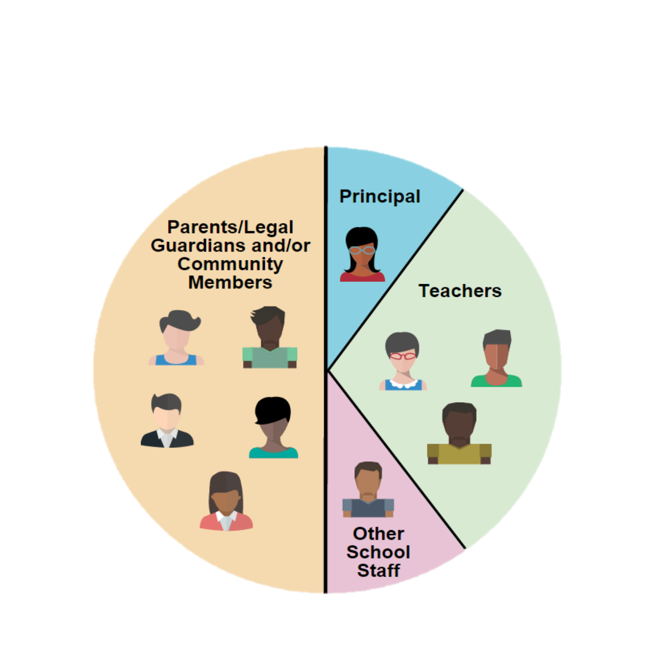
SSC ELEMENTARY COMPOSITION*
Not employed at the child’s school
Parent Member:
Is an individual who is a mother, father or legal guardian not employed at the school with which the council is affiliated.
Community member:
Resides and/or works within a specific school’s attendance boundary. PROOF IS REQUIRED.
On an annual basis, parents designate by vote whether to assign their parent member seat(s) on the council to eligible community members.
or designee
* All members must be elected by their peers, except the principal or his/her designee, who is the only automatic member.
*Please note if the principal appoints a designee, he/she serves the entire school year.
Notes:
This slide describes the composition of the SSC at our elementary school.
Read slide if appropriate and explain composition which is describe in the bylaws.

Slide 20
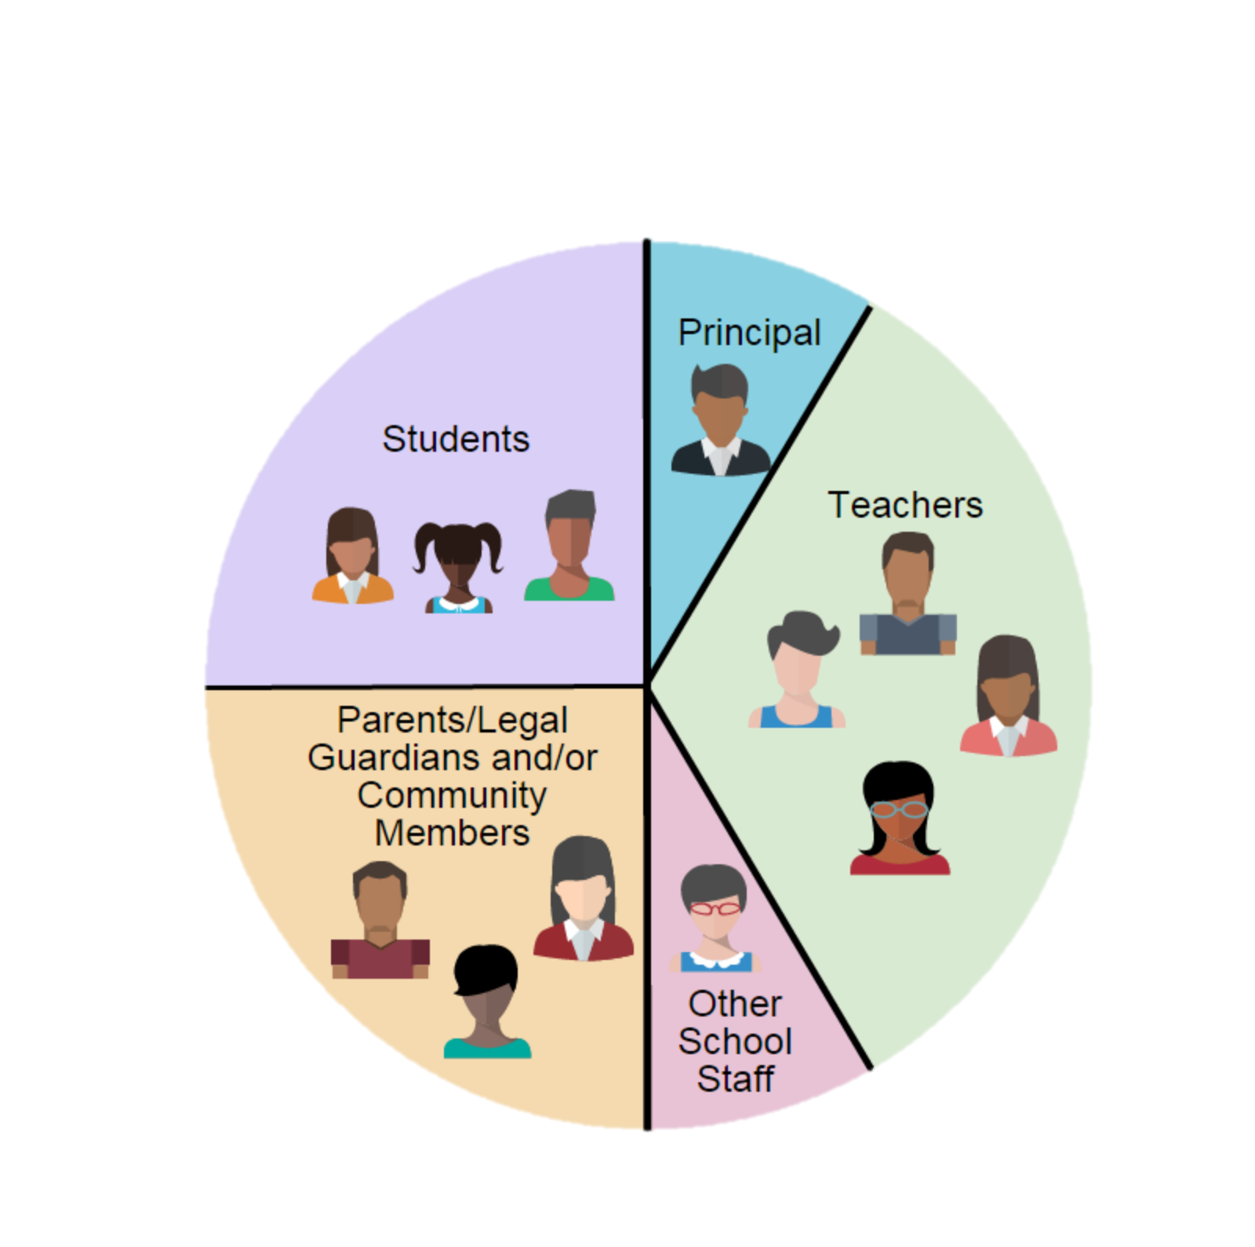
SSC SECONDARY COMPOSITION*
According to California Education Code, section 65000, for secondary schools:
parity between parents/community and students is required
parity between staff and non-staff is required
the SSC must be composed of at least 12 members
According to the California Education Code, section 33133(c), at middle schools, a SSC may, but is not required to, include student representation.
SAMPLE
or designee
25%
Parents/
Legal Guardian
Community
25%
Student (Secondary)
Not employed at the child’s school
*All members must be elected by their peers, except the principal or his/her designee, who is the only automatic member.
*Please note if the principal appoints a designee, he/she serves the entire school year.
Notes:
Read this slide if applicable. There have been changes in the secondary composition with regards to parity. Please review the bulletin 6745.2 (page… and Attachment R) for more information.

Slide 21
SSC ALTERNATES --OPTIONAL
Election of alternates for the council is optional.
Alternates should be elected for all stakeholder groups e.g. teachers, parents, students, and other school personnel, except the principal or designee.
The principal’s designee is not an alternate but a member of the SSC.
Alternates are not members until seated to replace current members upon a termination or resignation of membership.
Alternates do not have voting privileges and are not counted for the establishment of quorum, until seated to replace a member that can no longer serve. (Refer to Attachment B1)
Notes:
Read slide with regards to alternates.

Slide 22
OFFICERS FOR SSC
CHAIRPERSON
Preside at all meetings.
Sign all letters, reports and other communications of the council.
Perform all duties relevant to the office of the Chairperson.
Participate in the planning of the meeting agendas.
Have other such duties as are prescribed by the council.
VICE-CHAIRPERSON
Represent the Chairperson in assigned duties.
Substitute for the Chairperson in his or her absence.
Participate in the planning of the agenda.
SECRETARY
Conduct roll call to establish quorum.
Keep minutes of all regular and additional meetings of the council.
Provide the signed and dated original meeting minutes to the principal or designee.
Assist in keeping the records of the council.
Maintain a current roster of the council members.
Perform other such duties as are assigned by the Chairperson.
Participate in the planning of the agenda.
PARLIAMENTARIAN
Assist the Chairperson in ensuring all rules and bylaws are followed.
Be knowledgeable about the California Open Meeting Law (Greene Act), District policies, bylaws of the council, and selected parliamentary procedures.
Participate in the planning of the agenda.
Notes:
There are 4 officers for the SSC. Read slides
Once we have all SSC members elected (teachers, Other Personnel) we will hold officers election. Today we will only select _______ parent/community members.

Slide 23
SSC Verification Form
SSC Verifications and Documents due by September 25, 2020
(All uploads except ballots)

Slide 24
Schools and families working together to ensure student success
ORIENTATION FOR THE ENGLISH LEARNER ADVISORY COMMITTEE (ELAC)
Notes:
Now we are going to be doing the orientation for ELAC.

Slide 25
ENGLISH LEARNER ADVISORY COMMITTEE (ELAC)
In accordance with the California Education Code, section 52176(b), all schools with twenty-one or more English learner (EL) students, not including Reclassified Fluent English Proficient (RFEP) students, are required to establish an English Learner Advisory Committee (ELAC).
Schools are required to form the ELAC at any time during the school year when the number of identified EL students reaches 21 or more. All parents with students attending the school in which the ELAC is established are eligible and should be encouraged to participate in the ELAC.
The principal must ensure that ELAC members receive appropriate training.
Notes:
Read slides to indicate why we have an ELAC. We currently have over ____ English Learners in our school

Slide 26
ELAC FUNCTIONS AND RESPONSIBILITIES
Provide written recommendations to the SSC regarding programs and services for EL students (see Attachment G). Recommendations should be based on student performance and parental involvement data.
Advise on the development of the SPSA in relation to the English Learner Master Plan.
Advise on efforts to inform parents about the importance of regular school attendance, review the school’s student attendance data and the District’s student attendance policy.
Include on the meeting agendas information related to the District’s Master Plan for English Learners and Standard English Learners.
Use the Comprehensive School Needs Assessment to identify and address the linguistic and academic needs of EL students and to develop training and support for parents.
Notes:
This slide outlines ELAC responsibilities.

Slide 27
ELAC FUNCTIONS AND RESPONSIBILITIES (cont.)
Convene six times per year at a time that is agreeable to members. These six meetings do not include a mandatory orientation and election.
Adhere to the Greene Act as required by California Education Code 35147, provided bylaws (see Section V and Attachment B2) and Robert’s Rules of Order (see Attachment M).
Maintain the following documents on file (scanned electronic or hard copy) in a secure location for five years and be available for review during District, state and federal compliance reviews: orientation and election meeting announcements, ballots, minutes, records of attendance, agendas, handouts, ELAC recommendations to the SSC, SSC responses, official correspondence, and ELAC bylaws.
Notes:
Read slides

Slide 28
ELAC RECOMMENDATION PROCESS
English Learner
Advisory Committee
sends written recommendations to the SSC.
SSC must respond to written recommendations within 30 days, or at the next official SSC meeting.
Notes:
This is an important responsibility for ELAC. The committee members are to write recommendations to the SSC which will support English learners in the school. ELAC members are advisory only…they need to submit recommendations to the school’s decision making council. Then the SSC committee must consider the ELAC written recommendation and respond within the 30.

Slide 29
ELAC COMPOSITION
Parents and legal guardians of EL students, not employed by LAUSD, must constitute at least 51% of the total membership of the ELAC.
However, when the percentage of EL students in a school constitutes more than 51% of the total number of students, parents and legal guardians of EL students must equal or exceed the percentage of EL students in the school.
Notes:
Presenter notes:
ELAC in at least the same percentage as their children represent of the total number of pupils in the school.
Parents of non-EL students, not employed by the District.

Slide 30
ELAC COMPOSITION
The minimum number of ELAC members will depend on the number of English learner students in a school. The required number of ELAC members will be as follows:
Number of English learners in a School | Minimum Number of ELAC Members Required
21 to 75 ELs | A minimum of 3 total members required
76 to 150 ELs | A minimum of 5 total members required
151 to 225 ELs | A minimum of 7 total members required
226 ELs and above | A minimum of 9 total members required
Notes:
Our school has the following number of English learners therefore we will have a minimum number of ELAC members.

Slide 31
ELAC OFFICERS
CHAIRPERSON
Preside at all meetings of the ELAC.
Sign all letters, reports and other communications of the ELAC.
Perform all duties relevant to the office of the chairperson.
Participate in planning of meeting agendas.
Have other such duties as prescribed by the ELAC.
Serve as the school’s representative to the Local District ELAC Delegate Convening for DELAC Elections (no alternate will be allowed to participate in this role).
VICE-CHAIRPERSON
Represent the chairperson in assigned duties.
Substitute for the chairperson in his or her absence, except at Delegate Convening.
Participate in planning of the agenda.
SECRETARY
Keep minutes of all ELAC meetings. of the ELAC.
Transmit true and correct copies of meeting minutes to members of the ELAC.
Assist in the maintenance of ELAC records.
Maintain a current roster of ELAC members.
Participate in planning of the agenda.
Perform other such duties as are assigned by the chairperson of the ELAC.
PARLIAMENTARIAN
Assist the chairperson in ensuring all rules and bylaws are followed.
Vote on any matter submitted for a vote.
Be knowledgeable about parliamentary procedure, ELAC bylaws, Robert’s Rules of Order and the California Open Meeting Law (Greene Act).
Participate in planning of the agenda.
Notes:
ELAC will have four officers. Read the slides for each officers.

Slide 32
ELAC Verification Form
Verifications due by September 25, 2020

Slide 33
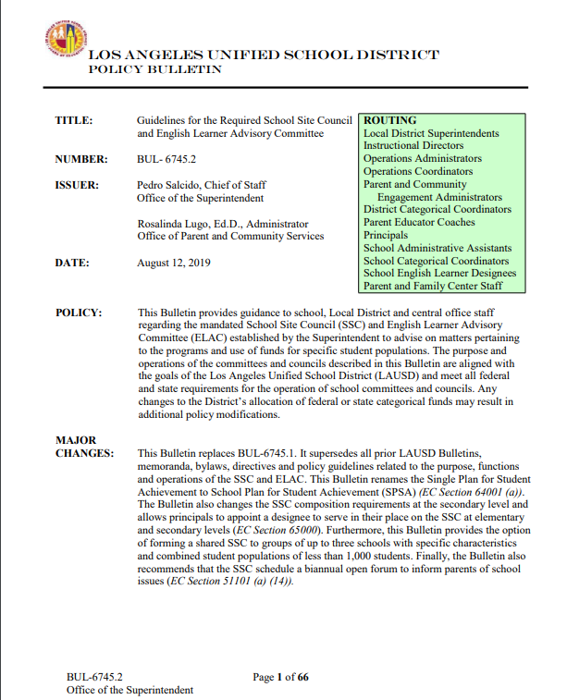
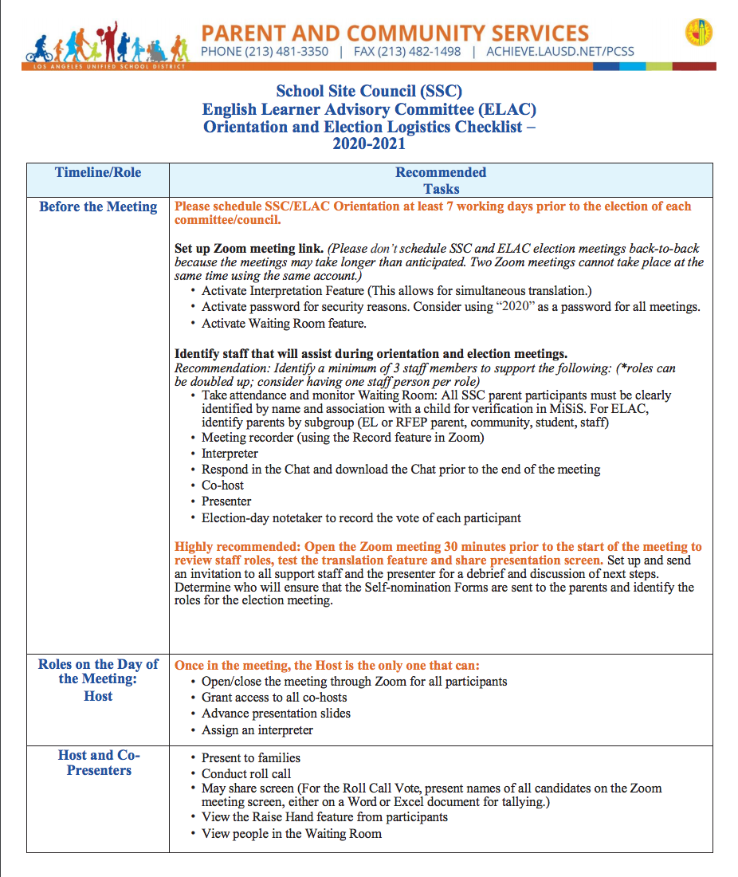
Resources
achieve.lausd.net/nwpace

Slide 34
UPDATE TO BULLETIN
Los Angeles Unified Bulletin 6745.2: Guidelines for the Required School Site Council and English Learner Advisory Committee provides guidance for school and District office administrators in the formation and functioning of the SSC and ELAC. Provisions of the policy were adapted and aligned to the guidance on public meetings provided by Governor GavinNewsom in Executive Order 10-25-20 in March of 2020 and the Los Angeles County Public Health recommendations for implementation beginning on August 2020.
OVERVIEW

Slide 35
L.A. COUNTY PUBLIC HEALTH RECOMMENDATIONS
Los Angeles County Public Health
has communicated the following:
“Use of school facilities for non-school purposes (community meeting or events, on-site clinic visits by people who are neither students nor staff, etc.) is not permitted."

Slide 36
SCHOOL SITE COUNCIL
&
ENGLISH LEARNER ADVISORY COMMITTEE
Parent Election Meeting Steps.
Calling all parents elections are coming!

Slide 37
ESTABLISH, AND COMMUNICATE TO STAKEHOLDERS, A GENERAL TIMELINE OF ACTIVITIES FOR THE PARENT ELECTIONS:
A. DISTRIBUTION OF FLYERS
B. ONLINE ORIENTATION.
C. DISTRIBUTION OF SELF-NOMINATION FORM TEMPLATE
D. POSTING OF PARENT ELECTION AGENDA ON-SITE AND ONLINE
E. ONLINE ELECTION OF NEW MEMBERS.
FOR PRESCREENING ELIGIBILITY OF CANDIDATES AND TO ASSIST
FAMILIES WITH ONLINE CONNECTIVITY
PROVIDE A FEW DAYS BETWEEN THE DATE OF SUBMISSION OF THE SELF-NOMINATION FORM AND THE ELECTION OF NEW MEMBERS.
IDENTIFY SPECIFIC DATES AND TIMES TO SEND NOTICES, EMAIL AND BLACKBOARD CONNECT TEXT AND/OR VOICE
MESSAGES AS REMINDERS.
OVERCOMMUNICATE THE MEETING OPPORTUNITIES TO FAMILIES.
STEP #1

Slide 38
ESTABLISH ZOOM LINKS FOR ORIENTATION
AND ELECTION MEETINGS
TRANSLATION AND WAITING ROOM FUNCTIONS ENABLED
IDENTIFY THE DIAL-IN CALLING INFORMATION.
STEP #2

Slide 39
DISTRIBUTE INFORMATION
DISTRIBUTE INFORMATION: MAIL, EMAIL AND BLACKBOARD CONNECT TEXT MESSAGES TO PARENTS ANNOUNCING ORIENTATION AND ELECTION INFORMATION
THE LINK FOR SUBMITTING A SELF-NOMINATION FORM. OFFER PARENTS THE OPTION TO CALL OR
EMAIL THE SCHOOL TO SPEAK WITH SOMEONE SPECIFIC FOR ASSISTANCE WITH COMPLETING THE FORMS.
STEP #3

Slide 40
HOLD AN ORIENTATION MEETING
ASK INTERESTED PARTICIPANTS TO IDENTIFY THEMSELVES IN THE CHAT
SUBMIT THE SELF-NOMINATION FORM AGAIN
IF THEY HAVE NOT ALREADY DONE SO, SEND THE FORM IN A LINK THROUGH THE CHAT FEATURE
SHARE ELECTION MEETING INFORMATION, SUCH AS DATE AND TIME
SAVE THE CHAT AND RECORD THE MEETING.
STEP #4

Slide 41
POSTING OF AGENDA
72 HOUR NOTICE. POST THE ELECTION AGENDA ON-SITE AND ONLINE
SEND THE ELECTION MEETING AGENDA, 72 HOURS
BEFORE THE MEETING
INCLUDE THE DATE, TIME, AND ZOOM LOG IN AND DIAL-IN CALLING INFORMATION
HOURS
STEP #5

Slide 42
ON THE DAY OF THE ELECTION
OPEN THE MEETING 30 MINUTES EARLY TO
RESOLVE CONNECTION ISSUES, REVIEW STAFF ROLES
TEST THE TRANSLATION FEATURE
THE NAMES OF THE SELF-NOMINATED CANDIDATES SHOULD BE PRESENTED SO THEY ARE ALL VISIBLE ON THE MEETING
SCREEN AT THE SAME TIME.
REMIND PARTICIPANTS THAT THE MEETING WILL BE RECORDED
STATE THAT NO OFFICIAL WINNER WILL BE DECLARED AT THE MEETING, BECAUSE PARTICIPANTS PRESENT AT THE MEETING NEED TO BE VERIFIED AS PARENTS IN MISIS.
RESTRICT THE CHAT FEATURE IN THE ZOOM MEETING SO PARTICIPANTS CAN ONLY COMMUNICATE WITH THE HOST/CO-HOST.
STEP #6

Slide 43
AT THE ELECTION
INFORM PARENTS HOW MANY SEATS ARE AVAILABLE AND THAT ONLY THEY CAN VOTE TO SURRENDER PARENT SEATS TO
COMMUNITY MEMBERS
INQUIRE ABOUT WHETHER THERE ARE ANY COMMUNITY MEMBERS AT THE MEETING WHO WANT TO SERVE AS SSC MEMBERS
A MOTION MUST BE MADE BY PARENTS STATING THE NUMBER OF SEATS THAT WERE OR WERE NOT SURRENDERED
CLARIFY HOW MANY (EX. THERE WERE NO SEATS SURRENDERED OR THERE WERE __SEATS SURRENDERED)
OPEN PARENT SEATS ARE AVAILABLE IF COMMUNITY MEMBERS SEATS ARE FILLED.
STEP #7

Slide 44
AT THE ELECTION
AT THE ELECTION, INFORM PARTICIPANTS THAT THE
CANDIDATE WITH THE HIGHEST VOTES WILL BE SEATED
PROVISIONALLY, PENDING VERIFICATION OF VOTING PARTICIPANTS
ONLY PARENTS MAY ELECT PARENTS (NOT COMMUNITY MEMBERS_
ALL CANDIDATES MUST BE PRESENT TO BE VOTED
FOR IN THE ROLL CALL VOTE
STAFF WILL CALL ON PARTICIPANTS TO STATE THEIR FULL
NAMES, CHILD’S NAME, AND VERBALLY ANNOUNCE THEIR
CANDIDATE SELECTION
IF A PARTICIPANT DOES NOT IDENTIFY HIMSELF, HIS VOTE
CANNOT BE DOCUMENTED
CANDIDATE SELECTIONS WILL BE TALLIED
VISIBLY. TALLY TOTALS MUST BE DOCUMENTED IN THE MEETING’S MINUTES.
EACH PARTICIPANT’S VOTE MUST BE CLEARLY NOTED BY STAFF, IN
CASE A PARTICIPANT’S STATUS AS A PARENT CANNOT BE VERIFIED
IN MISIS AND THE VOTE NEEDS TO BE ANNULLED.
STEP #8

Slide 45
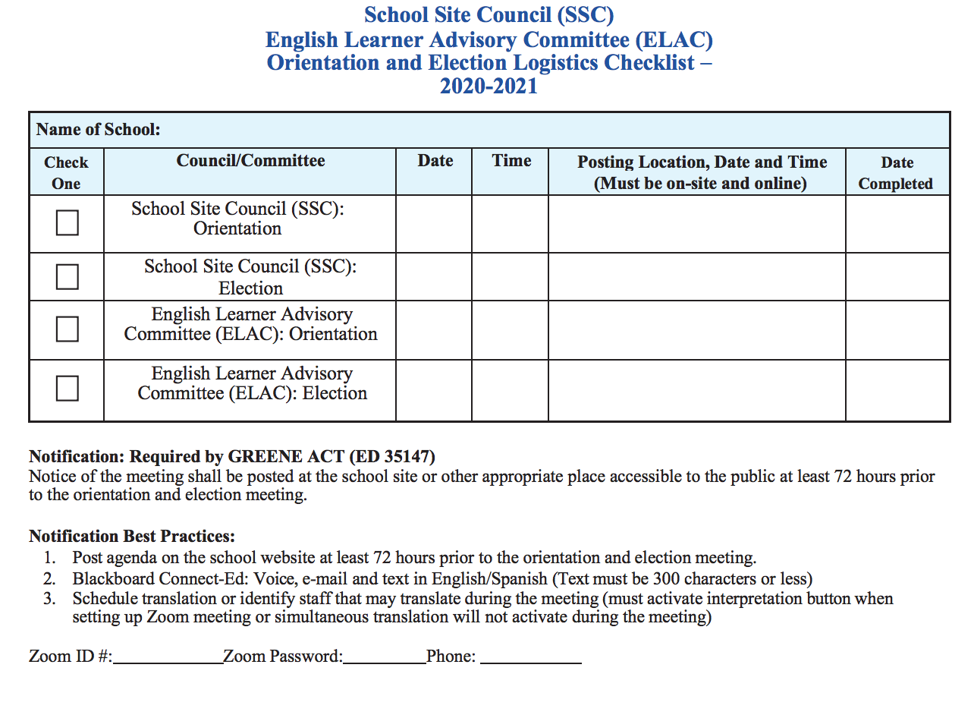
Logistics
Checklist

Slide 46
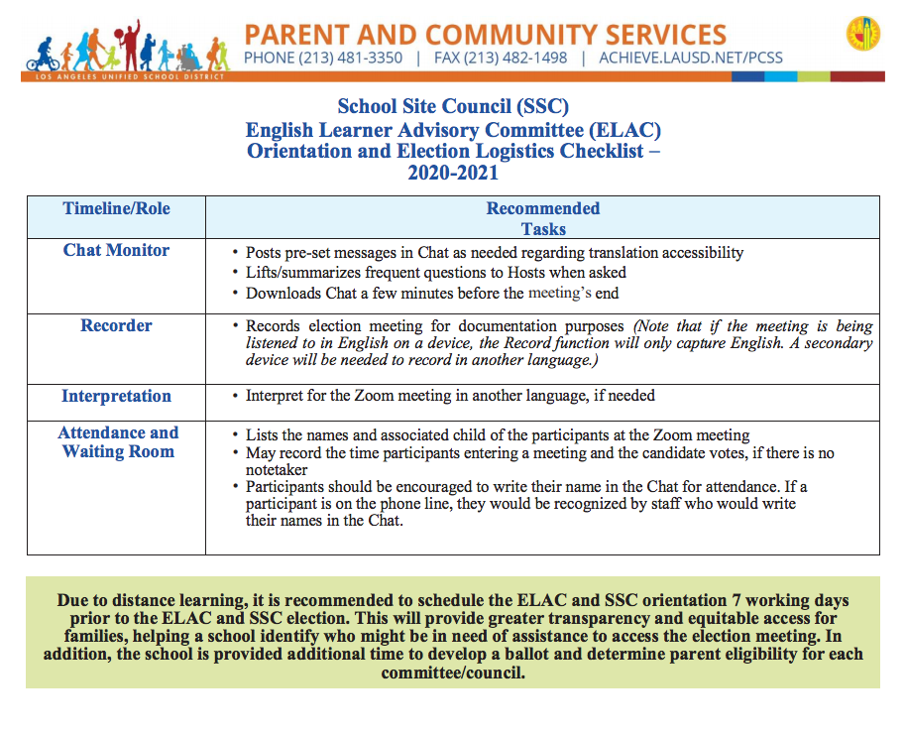
LOGISTICS CHECKLIST

Slide 47
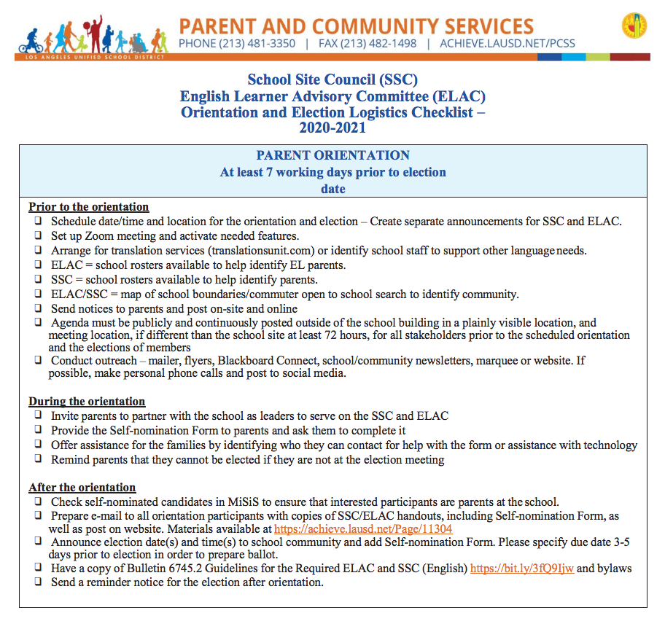
PARENT
ORIENTATION

Slide 48
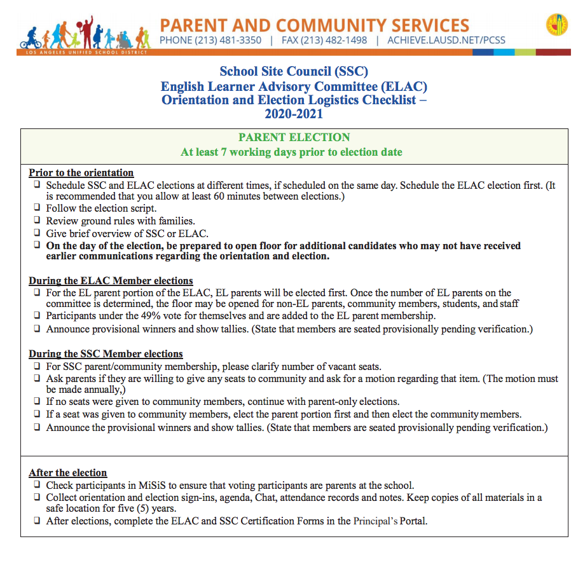
PARENT ELECTION

Slide 49
LDNW Study Groups
LCAP Study Group: Friday, September 11, 2020
Title I Study Group: Tuesday, November 3, 2020
ELAC Study Group: Tuesday, November 10, 2020
*Zoom Meeting ID’s will be provided on upcoming flyers

Slide 50
Save the Date
SSC/ELAC Drop-In Clinic – Wednesday, September 22, 2020
9:00 a.m. to 3:00 p.m.
ELAC Delegate Convening – Monday, October 26, 2020
9:00 a.m. to 12:00 p.m.
SSC Training – Saturday, October 17, 2020
8:30 a.m. to 12:30 p.m.
Evaluation Link:
https://forms.gle/4wWEpDGviwL9zrQL9

Slide 51
The following four slides on delegation of authority will not apply to most schools, and are only for schools that qualify, and whose ELAC considers going through the process, to delegate its authority and responsibilities to the School Site Council.
Notes:
Review the following slides if the ELAC might want to delegate the authority to the SSC.

Slide 52
DELEGATION OF AUTHORITY
The ELAC may designate the SSC or the SSC EL Subcommittee to function as the advisory committee for English learners (Education Code 52176) only when all of the following occurs:
The percentage of English learners does not exceed 50% in elementary schools or 25% in secondary schools.
The SSC has an EL subcommittee.
Either the parent portion of the SSC or a SSC EL subcommittee reflects at least the same percentage of parents of English learners as EL students enrolled in the school.
Notes:
Optional

Slide 53
DELEGATION OF AUTHORITY (continued)
Examples of EL Parent Portion on the SSC or SSC EL Subcommittee
 | #of SSC Members | # of students on SSC | # of parents on SSC | # of EL Parents on SSC | % of EL Parents on the parent portion of SSC | % of EL students in the school | ELAC is eligible to delegate authority to SSC? (Y/N)
Elementary Model | 10 | n/a | 5 | 2 | 40% | 46% | No
Elementary Model | 10 | n/a | 5 | 2 | 40% | 30% | Yes
*Secondary Model | 12 | 3 | 3 | 1 | 0% | 20% | No
*Secondary Model | 12 | 3 | 3 | 1 | 33% | 23% | Yes
Middle schools with no student representation | 12 | 0 | 6 | 3 | 17% | 24% | No
Middle schools with no student representation | 12 | 0 | 6 | 3 | 50% | 25% | Yes
*Secondary Model includes middle schools with student representation on their SSC.
Notes:
Optional

Slide 54
DELEGATION OF AUTHORITY (continued)
The delegation of authority cannot exceed two school years, including the school year during which delegation was approved by the PACE administrator.
ELAC members have been informed, during a regular (non-election) meeting, of the ELAC’s responsibilities prior to a vote to delegate authority to the SSC.
Discuss and vote, during an ELAC meeting at which quorum has been established, to delegate the ELAC responsibilities to the SSC.
A unanimous vote of the full ELAC membership present is required to approve delegation of authority to the SSC.
The decision must be documented in the ELAC meeting agenda and minutes.
Notes:
Optional

Slide 55
DELEGATION OF AUTHORITY (continued)
SSC accepted the responsibilities of the ELAC by unanimous vote at a meeting in which quorum has been established.
The decision must be documented in the SSC meeting agenda and minutes.
Submission of a Delegation of Authority form (Attachment F) signed by the SSC and ELAC Chairpersons and the principal to the Local District Parent and Community Engagement Administrator for final approval.
ELAC and SSC members are informed once delegation of authority has been duly completed and approved.
SSC or SSC EL Subcommittee participates in training to address all ELAC responsibilities which include all mandated CA Education Code topics.
Notes:
Optional

Slide 56
Thank you School Leaders
Thank you for volunteering to be a part of your school’s ELAC. We know that you will be spending time engaged in meaningful and important discussions with other stakeholders regarding the school’s English learners academic progress, linguistic and academic needs of EL students, and providing request to the school’s SSC on behalf of English learners.
Thank you for volunteering to be a part of your school’s SSC. We know that you will be spending time engaged in meaningful and important discussions with other stakeholders regarding the school’s SPSA, Safety Plan, Categorical Budgets, and listening to request by the school’s ELAC committee.
Please let the school staff know if there is additional information that you need to have a successful year as a member of the school’s SSC/ELAC.

Slide 57
Thank you!

Slide 58
QUESTIONS?

